Slide 1
Steps to Face Recognition
Python and JavaScript

Slide 2

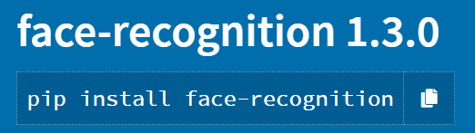


Libraries
Face Detection
Video Capture
Face Recognition
Accuracy of 99.38 %

Slide 3
Video Capture
let video = document.getElementById("cam_input"); // video is the id of video tag
navigator.mediaDevices.getUserMedia({ video: true, audio: false })
.then(function (stream) {
video.srcObject = stream;
video.play();
})
.catch(function (err) {
console.log("An error occurred! " + err);
});
let cap = new cv.VideoCapture(cam_input);
JavaScript

Slide 4
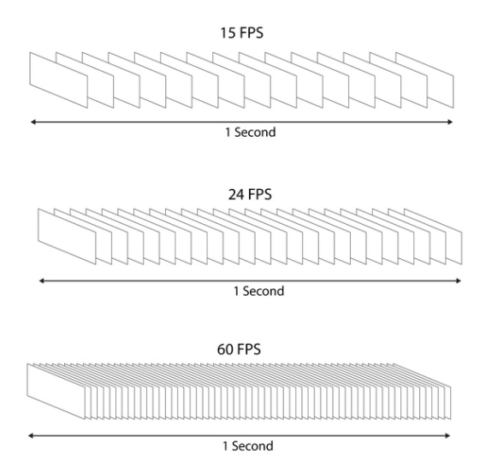
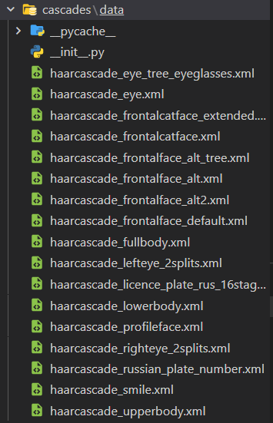
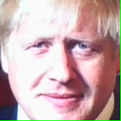
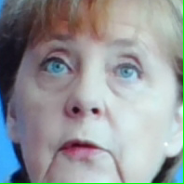
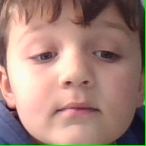
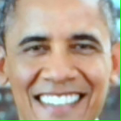
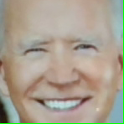

Face Detection
const FPS = 24;
let classifier = new cv.CascadeClassifier();
utils.createFileFromUrl(faceCascadeFile, faceCascadeFile, () => {
classifier.load(faceCascadeFile); // in the callback, load the cascade from file
});
let faces = new cv.RectVector();
let gray = new cv.Mat();
try {
classifier.detectMultiScale(gray, faces, 1.1, 3, 0);
//console.log(faces.size());
} catch (err) {
console.log(err);
}
for (let i = 0; i < faces.size(); ++i) {
face = faces.get(i);
let point1 = new cv.Point(face.x, face.y);
let point2 = new cv.Point(face.x + face.width, face.y + face.height);
}
JavaScript

Slide 5
Face Recognition - Enrollment
[array([ 7.04510063e-02, 1.15407310e-01, 2.66254460e-03, -2.31065322e-02,
-7.77263790e-02, -1.77585986e-02, 7.11222142e-02, -8.20401981e-02,
8.21929127e-02, -4.54524085e-02, 1.90576330e-01, -4.63409089e-02,
-2.69138008e-01, -1.33081630e-01, 1.57317147e-02, 1.19727790e-01,
-1.37577310e-01, -1.93274081e-01, -1.93941891e-01, -7.61727840e-02,
-1.46843297e-02, 2.85998397e-02, -2.68845111e-02, -8.15226883e-02,
-1.06395945e-01, -3.74697775e-01, 1.90299004e-02, -4.91538942e-02,
7.03979805e-02, -9.91002247e-02, 2.08060294e-02, 9.93548334e-02,
-1.21826120e-01, -4.76462059e-02, 5.29397801e-02, 2.11860314e-02,
-9.45629776e-02, -9.04240608e-02, 1.85026020e-01, 3.64707969e-02,
-1.86989561e-01, 5.38393632e-02, 5.60369641e-02, 3.21801513e-01,
2.38519579e-01, -2.80164704e-02, 4.37806994e-02, -4.42972183e-02,
5.74655235e-02, -2.93975592e-01, 1.11770801e-01, 1.38777778e-01,
1.39024645e-01, 1.40557706e-01, 1.20769560e-01, -1.16050407e-01,
-4.16843407e-02, 7.32867494e-02, -1.83152691e-01, -1.05600804e-04,
1.04721896e-01, -3.53503600e-03, -3.80403027e-02, -1.30587608e-01,
1.78102478e-01, 6.69110417e-02, -1.20444447e-01, -1.73559599e-02,
1.17295787e-01, -1.87125668e-01, -8.73445496e-02, -9.30972248e-02,
-5.53848781e-02, -1.06702767e-01, -2.34215811e-01, 4.53559011e-02,
2.55169392e-01, 2.08295465e-01, -2.31533110e-01, -4.84218970e-02,
-4.58793342e-02, 4.23947647e-02, 1.06741153e-01, -1.89603921e-02,
-8.62707421e-02, -1.37417465e-02, -4.49610576e-02, 1.20853111e-02,
1.64752603e-01, -3.48406509e-02, -7.90485367e-02, 2.10713267e-01,
5.37608936e-03, -8.01000819e-02, 8.10961276e-02, -1.80518012e-02,
-4.97585312e-02, -8.75188038e-03, -1.47795215e-01, 4.26039100e-04,
4.57902513e-02, -1.83042958e-01, 2.01111995e-02, 9.82818455e-02,
-1.46457613e-01, 1.98815003e-01, 2.43625436e-02, 5.89456484e-02,
8.65433812e-02, 1.23097049e-02, -5.74359894e-02, -4.61051017e-02,
1.36914432e-01, -2.12952226e-01, 2.32336819e-01, 1.76927999e-01,
1.40905194e-02, 1.19995929e-01, 5.46754636e-02, 4.72472310e-02,
-2.18723845e-02, -4.69265804e-02, -1.14133880e-01, -1.19943909e-01,
3.83354351e-03, 6.01958521e-02, 2.03014910e-02, 6.68271109e-02])]
# Get the byte content using `.read()`
image = image_file.read()
# convert to numpy array
npimg = np.frombuffer(image, np.uint8)
print(npimg)
img = cv2.imdecode(npimg, cv2.COLOR_BGR2GRAY)
face_encodings = face_recognition.face_encodings(img)
print(face_encodings)
save_enrollment(user_name, image_file, image_file.filename, face_encodings)
Python

Slide 6

Face Recognition - Recognition
[[0.0313456691801548, 0.0861259251832962, -0.006879683583974838, -0.03478752449154854, -0.08607915788888931, 0.0040351347997784615, 0.09298942983150482, -0.09807352721691132, 0.09661389887332916, -0.03849271684885025, 0.2051985263824463, -0.06345729529857635, -0.2883394658565521, -0.1045098602771759, -0.03439924120903015, 0.1290113925933838, -0.11544787138700485, -0.1977395862340927, -0.16178452968597412, -0.08006065338850021, -0.018977293744683266, -0.03719542920589447, -0.04614484682679176, -0.04940798133611679, -0.0950327143073082, -0.3572060763835907, 0.014022712595760822, -0.07688091695308685, 0.026734402403235435, -0.09046774357557297, 0.02862579934298992, 0.1273178607225418, -0.10085295140743256, -0.024999793618917465, 0.005846893414855003, 0.03155868873000145, -0.05996674671769142, -0.07608915865421295, 0.2408042699098587, 0.027859171852469444, -0.21311071515083313, 0.06545459479093552, 0.08938087522983551, 0.30368468165397644, 0.25148648023605347, -0.04931539297103882, 0.020482558757066727, -0.007138226181268692, 0.08537095040082932, -0.3064879775047302, 0.09203332662582397, 0.1592964380979538, 0.13768413662910461, 0.0982479378581047, 0.13480927050113678, -0.0919528603553772, -0.05138855427503586, 0.056907810270786285, -0.16502365469932556, -0.031019415706396103, 0.09654691070318222, -0.019336534664034843, -0.030319418758153915, -0.15071594715118408, 0.15539982914924622, 0.0862228274345398, -0.10641920566558838, -0.006376415491104126, 0.11239874362945557, -0.19114236533641815, -0.09573564678430557, -0.09724440425634384, -0.07392886281013489, -0.10011597722768784, -0.24046099185943604, 0.10002421587705612, 0.29752907156944275, 0.2160363346338272,
-0.20030760765075684, 0.015100263059139252, -0.03599068522453308, -0.005283800885081291, 0.10376205295324326, -0.028718251734972, -0.0692594051361084, -0.02930104359984398, -0.06687203794717789, -0.037237685173749924, 0.14625170826911926, -0.021113337948918343, -0.03942710906267166, 0.1809805929660797, -0.031152935698628426, -0.07784882187843323, 0.07889532297849655, 0.017090678215026855, -0.09177249670028687, 0.002687579020857811, -0.14775919914245605, -0.009948386810719967, 0.04076693207025528, -0.18076921999454498, 0.042060382664203644, 0.07114072144031525, -0.17022794485092163, 0.14397194981575012, -0.022270996123552322, 0.04594942182302475, 0.07090666890144348, 0.0313553586602211, -0.04053940623998642, -0.02542640082538128, 0.13518564403057098, -0.19342583417892456, 0.18952646851539612, 0.12524670362472534, -0.044923946261405945, 0.1009911298751831, 0.10475112497806549, 0.06632845848798752, -0.0390322171151638, -0.008513899520039558, -0.10840272903442383, -0.136301651597023, 0.012006386183202267, 0.06869443506002426, 0.03141716122627258, 0.07095891237258911]]
for encodings, username in get_all_username_encodings_zip():
print(encodings)
print(username)
try:
found_face = face_recognition.compare_faces(np.array(encodings), np.array(face_encodings_to_be_recognized), 0.6)
if True in found_face:
#first_match_index = found_face.index(True)
user_name = username
result = {
"status: " : "FOUND",
"username" : user_name
}
break
except:
return jsonify({
"status: " : "ERROR",
"username": user_name
})
Python

Slide 7
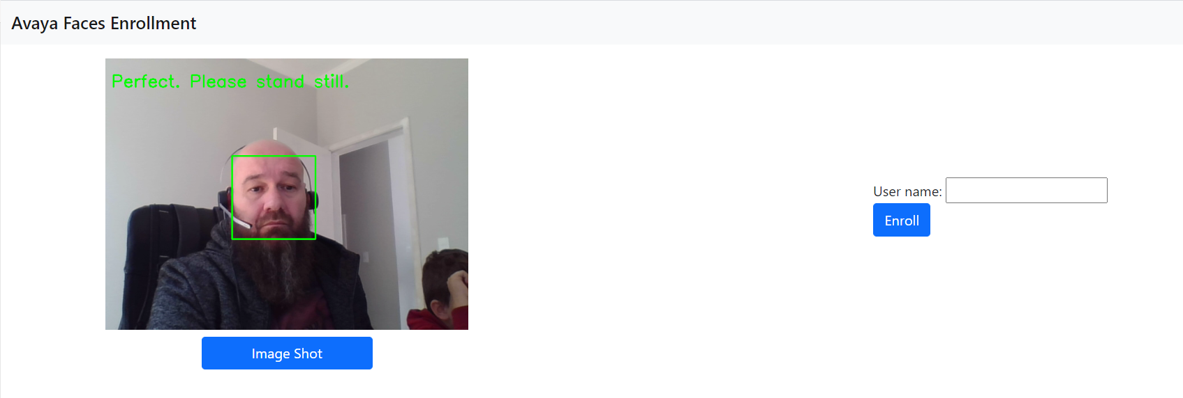
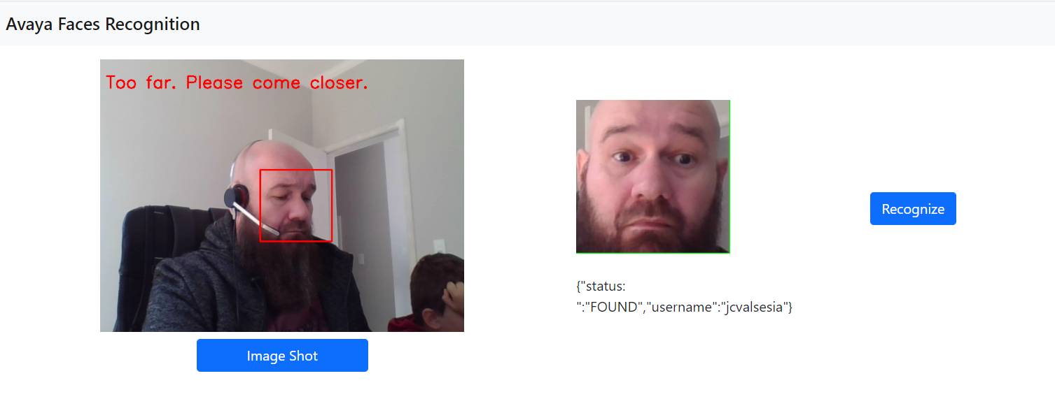
Demo

Slide 8
Thank you.

